Slide 1
Unit 8 Detective stories
Grammar

Slide 2
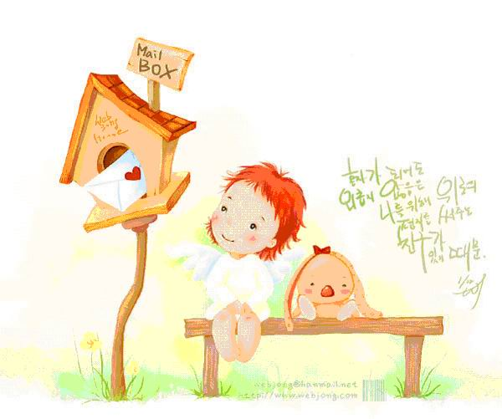
Task1 Learn some knowledge about the attributive clauses
1.定语
2.定语从句
3.先行词和关系词
4.关系词的作用
5.定语从句的结构

Slide 3

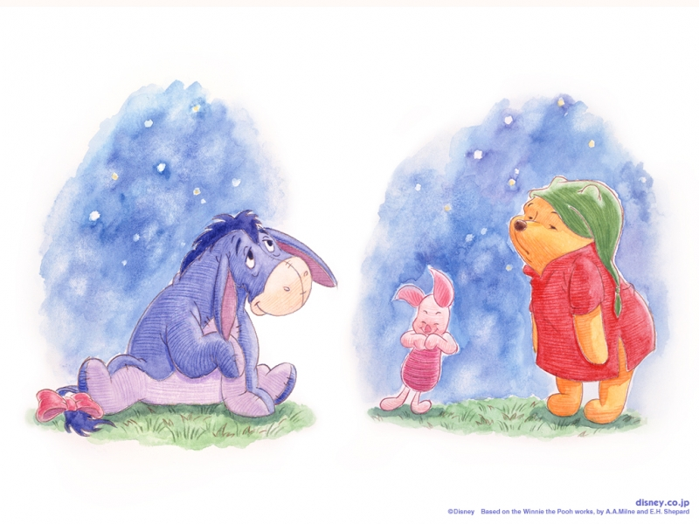
1.什么是定语(attribute)？
I like the colours.
Which colours?
energetic

Slide 4
定语---是对名词或代词起修饰、限定作用的词、短语、或句子。汉语中常翻译成“……的”
an ancient country
the colour of wisdom
the high-speed railway connecting A to B
the person who has influenced me most

Slide 5
前置定语---单词、或单个的分词做定语时通常放在它
修饰的词之前做前置定语
1.Wu Wei is a born artist.
2.Tan Dun loves the sounds of the rushing water.
后置定语--介词短语、分词短语和定语从句通常放在它所
修饰 的词之后，作后置定语
1.People in cold areas prefer warm colours in their
homes.
2.The Diary was written by a girl named Anne Frank.
3.He care for the children who have lost their parents.
4. The blood he has donated is enough to save over 70 lives.

Slide 6

.
2.什么是定语从句(attributive clause)？
I prefer the pencil.
which one ?
The pencil cost me 10 yuan.
I prefer cost me 10 yuan.
the pencil
which/that
The pencil
.
定语从句---在复合句中修饰名词或代词的句子

Slide 7
定语从句---在复合句中修饰名词或代词的句子
1.He never forgets the things he needs to do.
2.You should pay no attention to those who
laugh at you.
3.I gave my TV to Mary who could not afford one.
Tips:定语从句是修饰某一名词或代词的从句,于是我们只要
找到了被修饰的名词或代词，则修饰它的句子就是定语
从句。

Slide 8
Millie is writing down some sentences about the murder case. Help her decide whether they contain defining relative clauses. Underline the defining relative clauses.
More about the murder

Slide 9
The young man mentioned that he was going to visit his parents after work.
The elderly couple were very sad to hear that their only son was murdered.
The police are now checking the scene for fingerprints and other clues
that may help solve the case.
________________________

Slide 10
4. There was probably more than one person who had something to do with the murder.
5. A man who had blood on his shirt was seen running down Corn Street.
6. People hope that the police will catch the murderer soon.
_________________________
___________
______________________

Slide 11
3.什么是先行词和关系词？

Slide 12
My dad has a friend. He is good at English.
先行词
关系代词
My dad has a friend who/that is good at English.
定语从句
who/that为关系代词，在从句中代替friend.
3.先行词
——是被定语从句所修饰的词,通常是名
词或代词。
4.关系词
——是引导定语从句的关联词，
在从句中替代先行词。
注意: 从句必须紧跟在先行词后。

Slide 13
4. 关系词(relative pronoun) 的作用是什么呢？
a．引导定语从句；
b．代替先行词（先行词的一个替代形式）；
He wrote many books. The books sold well.
--- He wrote many books which/that sold well.
c．在定语从句中担当一个成分----主语或宾语
I don’t like the man that/who is smoking.（主语）
This is the reply (that/which) I’ve just received. (宾语)

Slide 14

5.定语从句的结构
1.He never forgets the things that/which he
needs to do.
2.You should pay no attention to those that/who
laugh at you.
3.Do you know the teachers that/who are sitting in
our classroom now?
….先行词（名词/代词）+关系代词（who/which/that/whom)+ ….

Slide 15
Task 3: How to use relative pronouns?
如何使用关系代词that/which/who/whom？

Slide 16
which 代替事物，在从句中充当主语或宾语
Group work
/that
1.I can’t find the letter. The letter came this morning.
2.Please give me the book. The book is about travel.
3.This is the bag. My mother bought it last week.
4. The house is made of wood. Jack built the house.
that
I can’t find the letter which came this morning.
Please give me the book which is about travel.
that
/
that
This is the bag which my mother bought last week.
/
that
The house which Jack built is made of wood.
关系代词在从句中作宾语时,可以省略;做主语时,不能省略。

Slide 17
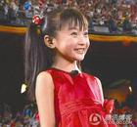
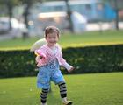
who 代替人,在从句中可充当主语。
Group work
Do you know the girl?
which girl?
1.The girl is running on the grass.
2. The girl likes singing very much.
1.Do you know is running on
the grass.
2.Do you know likes singing
very much.
the girl
?
The girl
who
the girl
?
who
The girl

Slide 18
that代替人，在从句中充当主语和宾语。
Group work
1.The boy is called Tom. The boy broke the window.
The boy that broke the window is called Tom.
2.Mr. Li is the person. You talked with the person on the bus.
Mr. Liu is the person that you talked with on the bus.
关系代词在从句中作宾语时，可以省略。
/

Slide 19
who / whom代替人,在从句中充当宾语。
Group work
He is the man. I told you about him.
He is the man
him
who
I told you about .
whom

Slide 20
Summary 关系代词的用法
How to use ‘Relative pronouns’?
 | 指人 | 指物 | 主语 | 宾语
that
which
who
whom
√
√
√
√
×
√
√
√
√
×
√
√
√
×
×
√
何时可以省略？
做宾语时可以省略

Slide 21
将两个句子合并成定语从句
1.找先行词
Match the two sentences
2.换关系词
3.加上其他部分
1.I’m reading an article. The article is about Tom.
I’m reading an article that/which is about Tom.
2. She is a teacher. The teacher teaches us English.
She is a teacher that/who teaches us English.
3. Where is the coat? You bought it last week.
Where is the coat which/that you bought last week?

Slide 22
小结：
that－ 既可指人，也可指物，关系代词that 指人时，相当于who; 指物时，相当于which。作主语，不能省略；作宾语，可以省略。
which－指物，作主语，不能省略；作宾语，可以省略.
who－ 指人，作主语，不能省略；作宾语，可以省略,（常用whom）

Slide 23
Task 4 强调特例

Slide 24
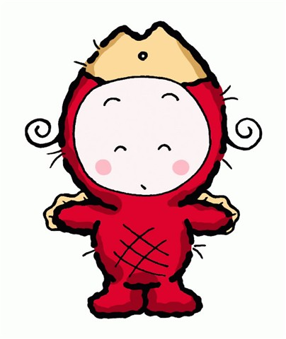
(1)当关系代词在定语从句中作主语时，
定语从句的谓语动词形式由先行词决定。
are
1.Those who against the plan put up
your hands. (be)
lives
2.The man who next to ours sells vegetables. (live)
were
3.Tom is one of the students who praised
by the teacher yesterday. (be)

Slide 25
(2)关系代词在定语从句中作宾语时可省略，作
主语则不可。
1. Did you read the book ________ I lend to you ?
A. whose B. / C. who D. what
2. Did you read the book _______was popular at
the moment.
A. that B. / C. who D. what
B
A

Slide 26
(3)that和which在指物的情况下一般都可
互换, 但在下列情况下, 一般用that而不
用which。
1) 先行词被everything, nothing, something, anything, all, little, much, none 等不定代词修饰时。
that
I am sure she has something _______ you can borrow.

Slide 27
2) 先行词被all, every, no, some, any, little, much等修饰时。
I’ve read all the books _____ are not mine.
3) 先行词被序数词或最高级修饰时。
This is the first book _____ he has read.
4) 先行词被the only, the very, the same, the last修饰时。
This is the very book ____ belongs to him.
that
that
that

Slide 28
Task 5 Do exercises

Slide 29

Simon and his friends are playing a game. Each person has to say something about detective stories. Use who, which or that to help them complete their sentences.
About detective stories

Slide 30
Simon: Edgar Allen Poe was the man (1)___________ first wrote detectives stories in English.
Millie: Japanese writes have written some great stories (2) ____________ require readers to check every tiny detail for possible clues to the criminal cases.
who / that
which / that

Slide 31
Daniel: Sherlock Holmes is a character (3)__________ was created by Arthur Conan Doyle as a master at solving crimes.
Suzy: Conan is a detective (4)__________ appears in a cartoon series popular among teenagers all over the world.
Kitty: Agatha Christie was a female writer (5) _________ is considered the queen of crime novels.
who / that
who / that
who / that

Slide 32
Solving the crimes
A reporter is interviewing a police officer on TV about the murder in West Town. Millie is talking notes. Help her complete the sentences using relative clauses.
1. A young man was murdered yesterday. / He was single.
A young man ____________________ was murdered yesterday.
who/that was single

Slide 33
2. A knife was found in a rubbish bin near Corn Street. / It was covered in blood.
A knife ____________________________ was found in a rubbish bin near Corn Street.
3. We need information. / It’ll help solve the case.
We need information ______________________________.
which/that was covered in blood
which/that will help solve the case

Slide 34
4. Here’s a drawing of the person. / He might be the murderer of the young man.
Here is the drawing of the person _______________________________________________.
who/that might be the murderer of the young man

Slide 35
A few days later, Millie is telling her dad about the murder. Complete their conversation with who, which or that and the expressions in the box.
is not allowed by the law
his boss had committed
killed the young man
was seen running down the street
Dad: Has there been any progress in the West Town murder case, Millie?

Slide 36
is not allowed by the law
his boss had committed
killed the young man
was seen running down the street
who/that killed the young man
Millie: Yes. The person _______________
_________________ was his boss!
Dad: Really? Why did he do it?

Slide 37
is not allowed by the law
his boss had committed
killed the young man
was seen running down the street
which/that isn’t allowed by the law
Millie: The boss did something _________
____________________. The victim wanted to report the crime _____________________________ to the police.
which/that his boss had committed

Slide 38
is not allowed by the law
his boss had committed
killed the young man
was seen running down the street
Dad: How terrible! What about the man ________________________
_______________.
who/that was seen running down the street

Slide 39
Millie: Well, it turned out that he had nothing to do with this case. He works in a meat market and the blood on his shirt was from killing hens and ducks. He was in a hurry to catch a bus!

Slide 40
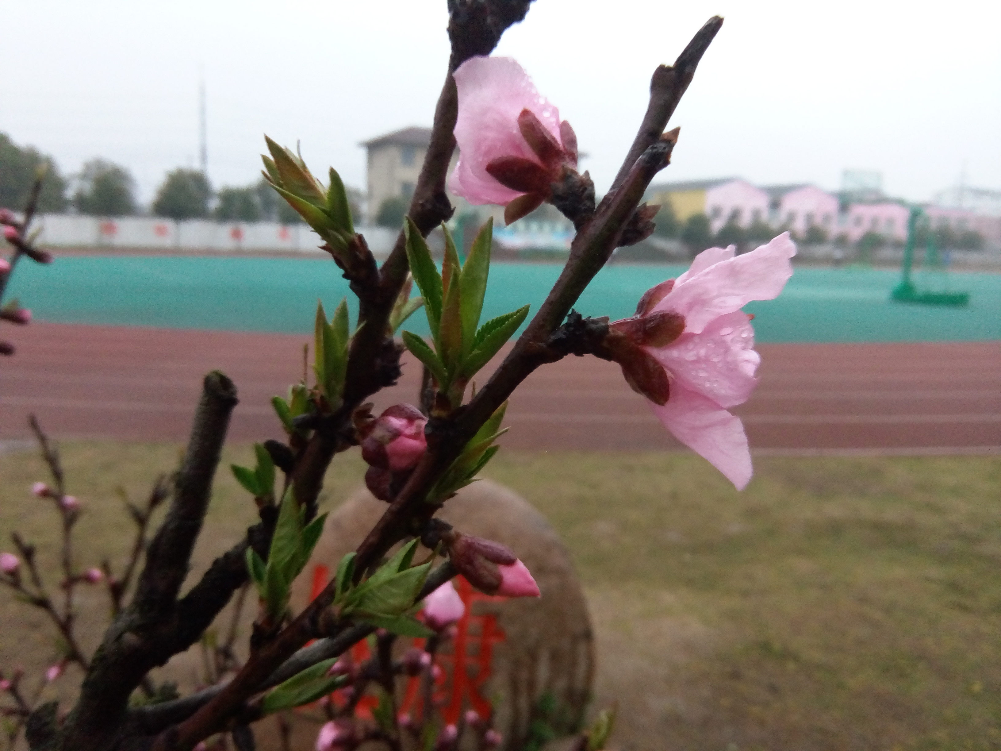
Thank you!

